Slide 1
Unit 1, Pt 4
Looking Inside the Body

Slide 2
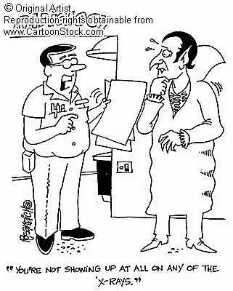
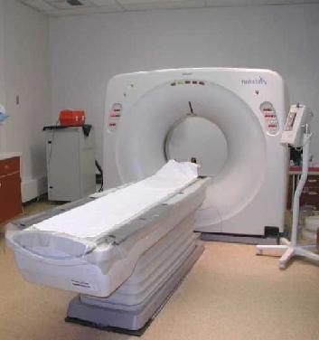
Clinical (Diagnostic) Terminology
Radiography –
Film records (radiographs) of internal structures of the body made by electromagnetic radiation (X-rays, gamma rays, radio waves) passing through the body to act on special film
CT/CAT (computerized axial tomography) –
Imaging technique that uses X-rays to reconstruct the body’s 3-D structure
CT/CAT scanning machine

Slide 3
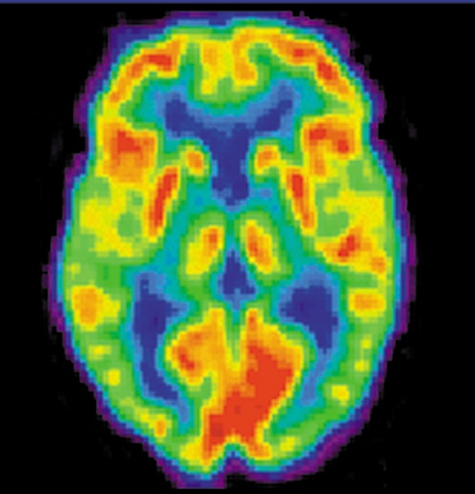
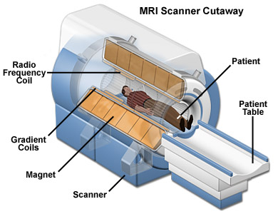
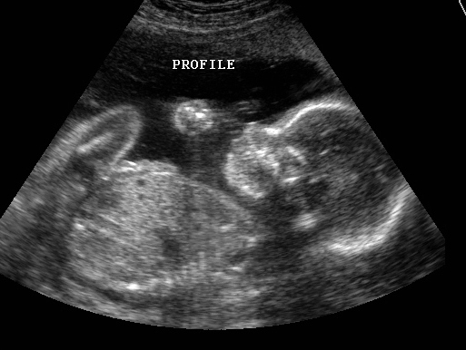
Clinical (Diagnostic) Terminology
PET scan of 20-yr old’s brain
PET (positron emission tomography) –
Imaging technique that shows the chemical functioning & structure of organs
MRI (magnetic resonance imaging) –
Imaging technique that uses a magnetic field & radio waves to show subtle structure differences
Ultrasound –
Imaging technique that uses brief bursts of high-frequency sound waves reflected by internal structures
Fetal ultrasound

